Slide 1
Elastic Cloud Application - Using AWS (CSE 546 Cloud Computing - Dr. Ming Zhao)
Gunda Akshay Kumar (1217179379)
Kusumakumari Vanteru (1217031218)
Tejaswi Paruchuri (1213268054)

Slide 2
Problem Statement
This project implements an Elastic Cloud Application that effectively utilizes the IAAS services (compute, storage and message) to provide an image recognition service, which uses a deep learning model to predict the images provided by users.
The application automatically scales in and out based on the demand i.e., number of requests received to the customer-facing web application.
Components Used, We have used the most widely used resources from Amazon Web Services(AWS) i.e.,
Amazon Elastic Compute Cloud (EC2) : WebTier0, Controller0, AppTier (0 to 17)
Amazon Simple Storage (S3) : cse546-input-p1, cse546-output-p1
Amazon Simple Queue Service (SQS) : CSE546_RequestQueue.fifo, CSE546_ResponseQueue.fifo

Slide 3
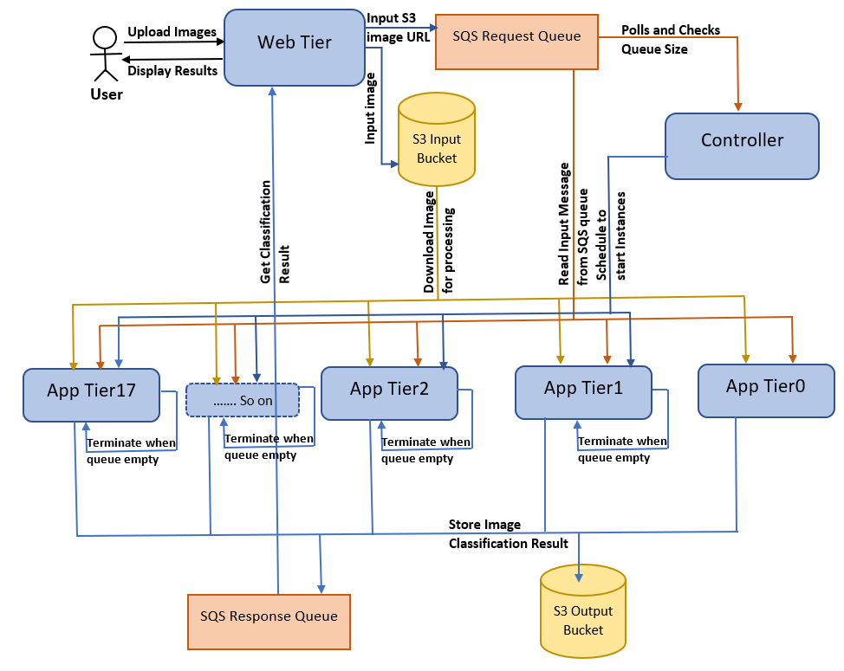
Architecture

Slide 4
Testing and Evaluation
Test Case 1: With 10 images
Test Case 2: With 100 images
Let’s test the system with 10 images and 100 images and evaluate the time taken to computes results using the deep learning model.
Total Time taken for Test case 1 : 39.22 sec
Total Time taken for Test case 2 : 98.28 sec

Slide 5
Thank You

